Slide 1
Application Layer

Slide 2
Where are we now?
Introduction to Networking
Basic Queuing Theory
Application Layer
Transport Layer
Network Layer and Routing
Data Link Layer
Medium Access Control SubLayer
Physical Layer
Further subjects (we will decide what to talk about based on the time left at the end of the semester)

Slide 3
Some network apps
e-mail
web
instant messaging
remote login
P2P file sharing
multi-user network games
streaming stored video (YouTube)
voice over IP
real-time video conferencing
cloud computing
…
…

Slide 4

Creating a network app
application
transport
network
data link
physical
write programs that
run on (different) end systems
communicate over network
e.g., web server software communicates with browser software
No need to write software for network-core devices
network-core devices do not run user applications
applications on end systems allows for rapid app development, propagation
application
transport
network
data link
physical
application
transport
network
data link
physical

Slide 5
Application architectures
client-server
peer-to-peer (P2P)
hybrid of client-server and P2P

Slide 6
Client-server architecture
clients:
INITIATE THE COMMUNICATION with server
may be intermittently connected
may have dynamic IP addresses
do not communicate directly with each other
server:
always-on host
permanent IP address
server farms for scaling
client/server

Slide 7
Pure P2P architecture
no always-on server
arbitrary end systems directly communicate
peers are intermittently connected and change IP addresses
The peer that initiates is called the client
highly scalable but difficult to manage
peer-peer

Slide 8
Hybrid of client-server and P2P
Skype
voice-over-IP P2P application
centralized server: finding address of remote party:
client-client connection: direct (not through server)
Instant messaging
chatting between two users is P2P
centralized service: client presence detection/location
user registers its IP address with central server when it comes online
user contacts central server to find IP addresses of buddies

Slide 9
Layered Architecture: Application Layer
host or
server
host or
server
controlled by
app developer
application
process
process
application
Ankara
Pittsburgh
Application Layer:
Ece wants to browse a web page located in a server in the US
It should look as if 2 processes communicate on the same machine
Network should be invisible: Network cloud

Slide 10
App-layer protocol defines
types of messages exchanged,
e.g., request, response
message syntax:
what fields in messages & how fields are delineated
message semantics
meaning of information in fields
rules for when and how processes send & respond to messages
public-domain protocols:
defined in RFCs (Request For Comment-online available standard-like document)
allows for interoperability
e.g., HTTP, SMTP
proprietary protocols:
e.g., Skype

Slide 11
Processes communicating
process: program running within a host.
within same host, two processes communicate using inter-process communication (defined by OS).
processes in different hosts communicate by exchanging messages
client process: process that initiates communication
server process: process that waits to be contacted
aside: applications with P2P architectures have client processes & server processes

Slide 12
Layered Architecture: Application Layer
host or
server
host or
server
application
transport
controlled by
app developer
application
transport
process
process
Ankara
Internet
Pittsburgh
Application Layer needs:
Process addressing
Delivery of the messages between peers
Additional: In-order reliable delivery, Throughput
Solution:
Application layer uses the services of the Transport Layer

Slide 13
Sockets
Process sends/receives messages to/from its socket
Information written to a socket by an application on one machine can be read by an application on another machine, and vice versa.
host or
server
host or
server
controlled by
app developer
process
process
socket
socket
TCP with
buffers,
variables
TCP with
buffers,
variables
Internet
controlled
by OS

Slide 14
Sockets: What are they?
Data structures representing a connection for processes
Provide communication between process, O/S (and network card, etc)
Buffers for sent / received information
Variables with addresses, port information, etc.
Methods (functions) for send / receive
A socket looks much like a stream to the application programmer
Open, read and write, close!
host or
server
host or
server
controlled by
app developer
process
process
socket
socket
TCP with
buffers,
variables
TCP with
buffers,
variables
Internet
controlled
by OS

Slide 15
Multiplexing / Demultiplexing
Multiplexing at send host:
Demultiplexing at rcv host:
delivering received segments on
the same NIC to the correct socket
gathering data from multiple
Sockets leave out of the same NIC
= socket
= process
application
application
application
P5
P4
P3
P1
P2
P1
transport
transport
transport
network
network
network
link
link
link
physical
physical
physical
host 1
(P3 and P4 mux)
host 2 (P1 and P2 demux)
host 3

Slide 16
What transport service does an app need?
MUST, CANNOT WORK WITHOUT THIS:
Process Addressing, delivery to the correct process
MUX/DEMUX
ADDITIONAL SERVICES:
Limited or No Data loss
Throughput
Timing
Security

Slide 17
Internet transport protocols services
UDP (User Datagram Protocol) service:
MUST SERVICES:
Addressing, mux/demux
Q: Where would you use UDP?
TCP (Transport Control Protocol) service:
MUST SERVICES:
Addressing, mux/demux
ADDITIONAL: connection-oriented:
Wire-like: in order, reliable delivery between sending and receiving processes
setup required between client and server processes
Keeps a connection state
Complex mechanism with retransmissions
Sockets are needed for both TCP and UDP
Their data structures are different for TCP and UDP

Slide 18
Internet apps: application, transport protocols
Application
layer protocol
SMTP [RFC 2821]
HTTP [RFC 2616]
FTP [RFC 959]
HTTP (Youtube), RTP [RFC 1889]
SIP, RTP, proprietary
(e.g., Skype)
Underlying
transport protocol
TCP
TCP
TCP
TCP or UDP
typically UDP
Application
e-mail
Web
file transfer
streaming multimedia
Internet telephony

Slide 19
Some application protocols
Web and HTTP
Electronic Mail
SMTP, POP3, IMAP
DNS (Domain Name Service)
P2P (Peer-to-Peer) Applications

Slide 20



WEB HTTP

Slide 21
Web and HTTP
www.someschool.edu/someDept/pic.gif
host name
path name
First, a review…
web page consists of objects
object can be HTML (HyperText Markup Language) file, JPEG image, Java applet, audio file,…
web page consists of a base HTML-file which includes several referenced objects
each object is addressable by a URL (Uniform Resource Locator )
example URL:

Slide 22
HTTP overview
HTTP: hypertext transfer protocol
Web’s application layer protocol
client/server model
client: browser that requests, receives, “displays” Web objects
server: Web server sends objects in response to requests
HTTP request
PC running
Chrome
HTTP response
HTTP request
Server
running
Apache Web
server
HTTP response
Mac running
Firefox

Slide 23
HTTP request message
two types of HTTP messages: request, response
HTTP request message:
ASCII (human-readable format)
carriage return character
line-feed character
request line
(GET, POST,
HEAD commands)
GET /index.html HTTP/1.1\r\n
Host: www-net.cs.umass.edu\r\n
User-Agent: Firefox/3.6.10\r\n
Accept: text/html,application/xhtml+xml\r\n
Accept-Language: en-us,en;q=0.5\r\n
Accept-Encoding: gzip,deflate\r\n
Accept-Charset: ISO-8859-1,utf-8;q=0.7\r\n
Keep-Alive: 115\r\n
Connection: keep-alive\r\n
\r\n
header
lines
carriage return,
line feed at start
of line indicates
end of header lines
Shows persistent
With time out period
to close TCP connection
if nothing is sent

Slide 24
HTTP response message
status line
(protocol
status code
status phrase)
HTTP/1.1 200 OK\r\n
Date: Sun, 26 Sep 2010 20:09:20 GMT\r\n
Server: Apache/2.0.52 (CentOS)\r\n
Last-Modified: Tue, 30 Oct 2007 17:00:02 GMT\r\n
ETag: "17dc6-a5c-bf716880"\r\n
Accept-Ranges: bytes\r\n
Content-Length: 2652\r\n
Keep-Alive: timeout=10, max=100\r\n
Connection: Keep-Alive\r\n
Content-Type: text/html; charset=ISO-8859-1\r\n
\r\n
data data data data data ...
header
lines
data, e.g.,
requested
HTML file

Slide 25
HTTP response status codes
status code appears in 1st line in server->client response message.
some sample codes:
200 OK
request succeeded, requested object later in this msg
301 Moved Permanently
requested object moved, new location specified later in this msg (Location:)
400 Bad Request
request msg not understood by server
404 Not Found
requested document not found on this server
505 HTTP Version Not Supported

Slide 26
HTTP overview (continued)
Uses TCP as Transport Layer Protocol:
client initiates TCP connection (creates socket) to server, port 80
Transport layer port: Process address
server accepts TCP connection from client
HTTP messages (application-layer protocol messages) exchanged between browser (HTTP client) and Web server (HTTP server)
TCP connection closed

Slide 27
Transport Layer Overhead
definition of RTT (Round Trip Time) : time for a packet to travel from client to server and back. Excluding the transmission time.
The first RTT is because of transport layer protocol TCP.
HTTP Application Layer protocol defines the transport layer as TCP.
TCP: Processes have connections
Connection: socket and other state variables for the process
Connection has to be established first.
Increases the response time for the client.
initiate TCP
connection
RTT
request
file
RTT
time to
transmit
file
file
received
time
time
time
time

Slide 28
HTTP connections
non-persistent HTTP
at most one object sent over TCP connection.
persistent HTTP
multiple objects can be sent over single TCP connection between client, server.

Slide 29
Nonpersistent HTTP
suppose user enters URL:
www.someSchool.edu/someDepartment/home.index
(contains text,
references to 10
jpeg images)
1a. HTTP client initiates TCP connection to HTTP server (process) at www.someSchool.edu on port 80
1b. HTTP server at host www.someSchool.edu waiting for TCP connection at port 80. “accepts” connection, notifying client
2. HTTP client sends HTTP request message (containing URL) into TCP connection socket. Message indicates that client wants object someDepartment/home.index
3. HTTP server receives request message, forms response message containing requested object, and sends message into its socket
time

Slide 30
Nonpersistent HTTP (cont.)
4. HTTP server closes TCP connection.
5. HTTP client receives response message containing html file, displays html. Parsing html file, finds 10 referenced jpeg objects
time
6. Steps 1-5 repeated for each of 10 jpeg objects

Slide 31
Persistent HTTP
non-persistent HTTP issues:
requires 2 RTTs per object
OS overhead for each TCP connection
browsers often open parallel TCP connections to fetch referenced objects
persistent HTTP
server leaves connection open after sending response
subsequent HTTP messages between same client/server sent over open connection
client sends requests as soon as it encounters a referenced object
Saves one RTT for TCP set up time for each of the referenced objects

Slide 32
HTTP: Response time
initiate TCP
connection
initiate TCP
connection
RTT
RTT
request
file
request
file
RTT
time to
transmit
file
RTT
time to
transmit
file
file
received
file
received
RTT
time to
transmit
file
time
file
received
time
time
time
Non-persistent response time for N objects: N*(2RTT+transmit time)
time
time
Persistent response time for N objects: RTT+N*(RTT+transmit time)

Slide 33
Persistent Non-Persistent
Persistent
Advantages:
Less RTT overhead, faster content delivery
less packets on the network
Disadvantages:
Connection occupies server resource until time out
Complex
Non-persistent
Advantages:
Simple
Less Server resources
Disadvantages:
More RTT,
More Packets

Slide 34
User-server state: cookies
HTTP is “stateless”
server maintains no information about past client requests
many Web sites use cookies
four components:
1) cookie header line of HTTP response message
2) cookie header line in HTTP request message
3) cookie file kept on user’s host, managed by user’s browser
4) back-end database at Web sites
how to keep “state”:
protocol endpoints: maintain state at sender/receiver over multiple transactions
cookies: http messages carry state

Slide 35
Cookies: keeping “state” (cont.)
client
server
ebay 8734
usual http request msg
Amazon server
creates ID
1678 for user
cookie file
usual http response
Set-cookie: 1678
create
entry
ebay 8734
amazon 1678
usual http request msg
cookie: 1678
cookie-
specific
action
access
one week later:
usual http response msg
backend
database
access
ebay 8734
amazon 1678
usual http request msg
cookie: 1678
cookie-
specific
action
usual http response msg

Slide 36
Cookies (continued)
what cookies can bring:
authorization
shopping carts
recommendations
user session state (Web e-mail)
cookies and privacy:
cookies permit sites to learn a lot about you
you may supply name and e-mail to sites

Slide 37
Caching
A partial storage of data closer to the requesting node for faster response and better load balance
Web Caching
DNS Caching

Slide 38

Web caches (proxy server)
Goal: satisfy client request without involving origin server
user sets browser: Web accesses via cache
browser sends all HTTP requests to cache
object in cache: cache returns object
else cache requests object from origin server, then returns object to client
origin
server
Proxy
server
HTTP request
HTTP request
client
HTTP response
HTTP response
HTTP request
HTTP response
client
origin
server

Slide 39
Web Caching Advantages
Problem:
Too much load on the access link
Increasing access link capacity is expensive
LAN is not utilized
Solution: Web Caching
reduce response time for client request
reduce traffic on an institution’s access link.
enables “poor” content providers to effectively deliver content

Slide 40


EMAIL

Slide 41
Electronic Mail
outgoing
message queue
user mailbox
User Agent
a.k.a. “mail reader”
composing, editing, reading mail messages
e.g., Eudora, Outlook, elm, Mozilla Thunderbird
outgoing, incoming messages stored on server
user
agent
mail
server
user
agent
SMTP
mail
server
user
agent
SMTP
SMTP
mail
server
user
agent
user
agent
user
agent

Slide 42
Electronic Mail: mail servers
Mail Servers
mailbox contains incoming messages for user
message queue of outgoing (to be sent) mail messages
SMTP protocol between mail servers to send email messages
client: sending mail server
“server”: receiving mail server
user
agent
mail
server
user
agent
SMTP
mail
server
user
agent
SMTP
SMTP
mail
server
user
agent
user
agent
user
agent

Slide 43
Electronic Mail: SMTP
uses TCP to reliably transfer email message from client to server, port 25
direct transfer: sending server to receiving server
three phases of transfer
handshaking (greeting)
transfer of messages
closure
command/response interaction
commands: ASCII text
response: status code and phrase
messages must be in 7-bit ASCII
uses persistent TCP connections
user
agent
mail
server
user
agent
SMTP
mail
server
user
agent
SMTP
SMTP
mail
server
user
agent
user
agent
user
agent

Slide 44


Scenario: Alice sends message to Bob
1) Alice uses UA to compose message and “to” bob@someschool.edu
2) Alice’s UA sends message to her mail server; message placed in message queue
3) Client side of SMTP opens TCP connection with Bob’s mail server
4) SMTP client sends Alice’s message over the TCP connection
5) Bob’s mail server places the message in Bob’s mailbox
6) Bob invokes his user agent to read message
1
mail
server
mail
server
user
agent
user
agent
2
3
6
4
5

Slide 45
Mail access protocols
SMTP
SMTP
access
protocol
user
agent
user
agent
sender’s mail
server
receiver’s mail
server
SMTP: delivery/storage to receiver’s server
mail access protocol: retrieval from server
POP: Post Office Protocol
IMAP: Internet Mail Access Protocol
HTTP: gmail, Hotmail, Yahoo! Mail, etc.

Slide 46
POP3 and IMAP
POP3
authorization (agent <-->server)
uses “download and delete” mode.
user cannot re-read e-mail if he changes client
“download-and-keep”: copies of messages on different clients
POP3 is stateless across sessions
IMAP
More complex
keeps all messages in one place: at server
allows user to organize messages in folders
keeps user state across sessions:
names of folders and mappings between message IDs and folder name

Slide 47
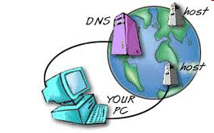
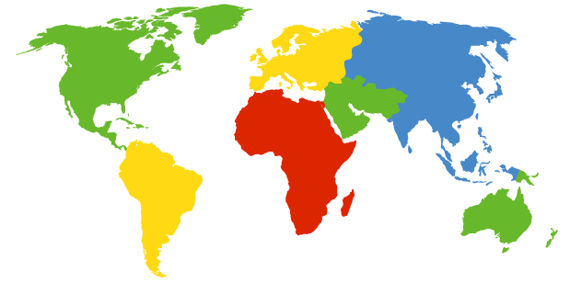
DNS: Domain Name System
a Verisign, Dulles, VA
c Cogent, Herndon, VA (also LA)
d U Maryland College Park, MD
g US DoD Vienna, VA
h ARL Aberdeen, MD
j Verisign, ( 21 locations)
k RIPE London (also 16 other locations)
i Autonomica, Stockholm (plus 28 other locations)
e NASA Mt View, CA
f Internet Software C. Palo Alto, CA (and 36 other locations)
m WIDE Tokyo (also Seoul, Paris, SF)
b USC-ISI Marina del Rey, CA
l ICANN Los Angeles, CA

Slide 48
DNS: Domain Name System
Internet hosts, routers:
IP address (32 bit) - used for addressing the devices at the network layer
“name”, e.g., metu.edu.tr in www.metu.edu.tr - used by humans must be translated to 144.122.144.188
If the IP address changes to 144.122.144.188 then www.metu.edu.tr must still work
1
2
requesting host located at
ece.cmu.edu
wants to connect to
metu.edu.tr

Slide 49
DNS: Domain Name System
First idea: Single server that contains all the mappings
Advantage: Simple
Disadvantages:
Single point of failure
Traffic volume
Distance
Maintanence
Solution: Distributed Database
1: metu.edu.tr ?
2: 144.122.144.188 !
requesting host

Slide 50
DNS: domain name system
distributed database implemented in hierarchy of many name servers
application-layer protocol: hosts, name servers communicate to resolve names (address/name translation)
note: core Internet function, implemented as application-layer protocol
complexity at network’s “edge”

Slide 51
DNS: domain name system
Primarily uses the User Datagram Protocol (UDP) on port number 53
DNS queries consist of a single UDP request from the client followed by a single UDP reply from the server.
The Transmission Control Protocol (TCP) is used when the response data size exceeds 512 bytes, or for tasks such as zone transfers.
Some resolver implementations use TCP for all queries.

Slide 52
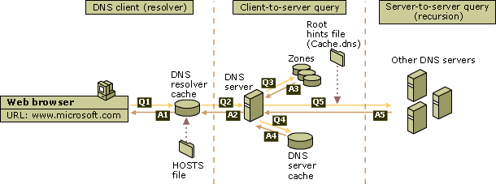
DNS Query
DNS query process occurs in two parts:
A name query begins at a client computer and is passed to a resolver, the DNS Client service, for resolution.
When the query cannot be resolved locally, DNS servers can be queried as needed to resolve the name.
https://technet.microsoft.com/en-us/library/cc775637(v=ws.10).aspx

Slide 53
Local Resolver
The local resolver cache can include name information obtained from two possible sources:
Hosts file
Resource records obtained in answered responses from previous DNS queries are added to the cache and kept for a period of time.
If the query does not match an entry in the cache, the resolution process continues with the client querying a DNS server to resolve the name.

Slide 54
Local Resolver
does not strictly belong to DNS Server hierarchy
each ISP (residential ISP, company, university) has one
also called “default name server”
when host makes DNS query, query is sent to its local DNS server
has local cache of recent name-to-address translation pairs (but may be out of date!)
acts as proxy, forwards query into hierarchy

Slide 55
DNS Servers: Types and Hierarchy
Root Name Server:
They know the IP addresses of the authoritative servers that handle DNS queries for the Top Level Domains (TLD) like “.com”.
top-level domain (TLD) servers:
responsible for com, org, net, edu, aero, jobs, museums, and all top-level country domains, e.g.: uk, fr, ca, jp
authoritative DNS servers:
Know the mappings
organization’s own DNS server(s), providing authoritative hostname to IP mappings for organization’s named hosts
can be maintained by organization or service provider
recursive DNS servers:
Gets the mapping from an authoritative DNS server and provides it to web clients.
TLD Servers: http://www.iana.org/domains/root/db,
http://www.iana.org/domains/root/db/com.html)
Root servers: http://www.root-servers.org/

Slide 56

DNS name resolution example
root DNS server
2
host at cis.poly.edu wants IP address for gaia.cs.umass.edu
3
TLD DNS server
4
5
iterated query:
contacted server replies with name of server to contact
“I don’t know this name, but ask this server”
local DNS server
dns.poly.edu
7
6
1
8
authoritative DNS server
dns.cs.umass.edu
requesting host
cis.poly.edu
gaia.cs.umass.edu

Slide 57
DNS name resolution example
root DNS server
2
3
host at cis.poly.edu wants IP address for gaia.cs.umass.edu
7
6
TLD DNS
server
recursive query:
puts burden of name resolution on contacted name server
heavy load at upper levels of hierarchy?
local DNS server
dns.poly.edu
5
4
1
8
authoritative DNS server
dns.cs.umass.edu
requesting host
cis.poly.edu
gaia.cs.umass.edu

Slide 58
Mix and Match
root DNS server
2
iterated query
3
4
7
recursive query
local DNS server
dns.eurecom.fr
TLD DNS server
dns.umass.edu
5
6
1
8
authoritative name server
dns.cs.umass.edu
requesting host
surf.eurecom.fr
gaia.cs.umass.edu

Slide 59
Workload and Caching
DNS responses are cached
Quick response for repeated translations
Other queries may reuse some parts of lookup
TLD servers typically cached in local name servers
thus root name servers not often visited
Cached data periodically times out
Lifetime (TTL) of data controlled by owner of data
TTL passed with every record
Cached the IP address of gaia.cs.umass.edu
local name server
dns.eurecom.fr
1
2
requesting host
surf.eurecom.fr

Slide 60

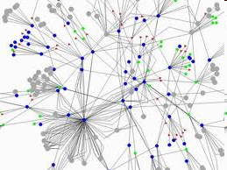
Peer-to-Peer

Slide 61
P2P: A distributed System Architecture
The information is not located in a central location but is distributed among all peers
A peer may need to communicate with multiple peers to locate a piece of information
No centralized control
Typically many heterogeneous nodes
Nodes are symmetric in function: both client and server
Takes advantage of distributed, shared resources (bandwidth, CPU, storage) on peer-nodes
Fault-tolerant, self-organizing
Operates in dynamic environment, frequent join and leave is the norm

Slide 62
File Distribution: Server-Client vs P2P
Question : How much time to distribute a file of size F from one server to N clients?
N copies must be
downloaded
Server
u₁
d₁
u₂
u_{s}: server upload bandwidth
u_{s}
d₂
File, size F
u_{i}: client i upload bandwidth
d_{N}
Network (with
abundant bandwidth)
d_{i}: client download bandwidth
u_{N}

Slide 63
File distribution time: server-client
Server
server sends N copies:
NF/u_{s} time
Each client i takes F/d_{i} time to download
F
u₁
d₁
u₂
u_{s}
d₂
d_{N}
Network (with
abundant bandwidth)
u_{N}
CAN NOT BE FASTER THAN THIS!
Lower bound on
Time to distribute F
to N clients using
client/server approach
= d_{cs} = max { NF/u_{s}, F/min(d_{i}) }
increases linearly in N
(for large N)

Slide 64
File distribution time: P2P
server must send the first copy: F/u_{s} time
client i takes F/d_{i} time to download
NF bits must be downloaded (aggregate)
fastest possible total upload rate: u_{s} + Σu_{i}
Server
F
u₁
d₁
u₂
u_{s}
d₂
d_{N}
Network (with
abundant bandwidth)
u_{N}
CAN NOT BE FASTER THAN THIS!
d_{P2P} = max { F/u_{s}, F/min(d_{i}) , NF/(u_{s} + Σu_{i}) }

Slide 65
Server-client vs. P2P: example

Slide 66
File distribution: BitTorrent
P2P file distribution application layer protocol
tracker: a computer that tracks peers participating in torrent
Does not have any content
torrent: group of
peers exchanging
chunks of a file
torrent: also the file that contains
data about the files
to be shared
and about the tracker
obtain list
of peers
trading
chunks
peer

Slide 67
File distribution: BitTorrent Tracker
keeps track of where file copies reside on peer machines
which ones are available at time of the client request
helps coordinate efficient transmission and reassembly of the copied file.
the only major critical point: clients are required to communicate with the tracker to initiate downloads.
there can be extensions to solve this problem

Slide 68
File distribution: BitTorrent
Peers that want to download the file must:
obtain a torrent file for it
connect to the specified tracker, which tells them from which other peers to download the pieces of the file.
Differences from FTP:
Over multiple TCP connections
Pieces of the file are not downloaded sequentially

Slide 69
BitTorrent (1)
file divided into 256KB chunks.
peer joining torrent:
has no chunks, but will accumulate them over time
registers with tracker to get list of peers, connects to subset of peers (“neighbors”)
while downloading, peer uploads chunks to other peers.
peers may come and go (peer churn)
once peer has entire file, it may (selfishly) leave or (altruistically) remain

Slide 70
BitTorrent (2)
Sending Chunks: tit-for-tat
Alice sends chunks to four neighbors currently sending her chunks at the highest rate
re-evaluate top 4 every 10 secs
every 30 secs: randomly select another peer, starts sending chunks
newly chosen peer may join top 4
“optimistically unchoke”
Pulling Chunks
at any given time, different peers have different subsets of file chunks
periodically, a peer (Alice) asks each neighbor for list of chunks that they have.
Alice sends requests for her missing chunks
rarest first

Slide 71

P2P Case study: Skype
inherently P2P: pairs of users communicate.
proprietary application-layer protocol (inferred via reverse engineering)
Super Nodes:
Hierarchical overlay
Relay communications for clients behind firewalls and Symmetric NAT.
Distributed hosting of Index maps usernames to IP addresses
Skype clients (SC)
Skype
login server
Supernode
(SN)

Slide 72
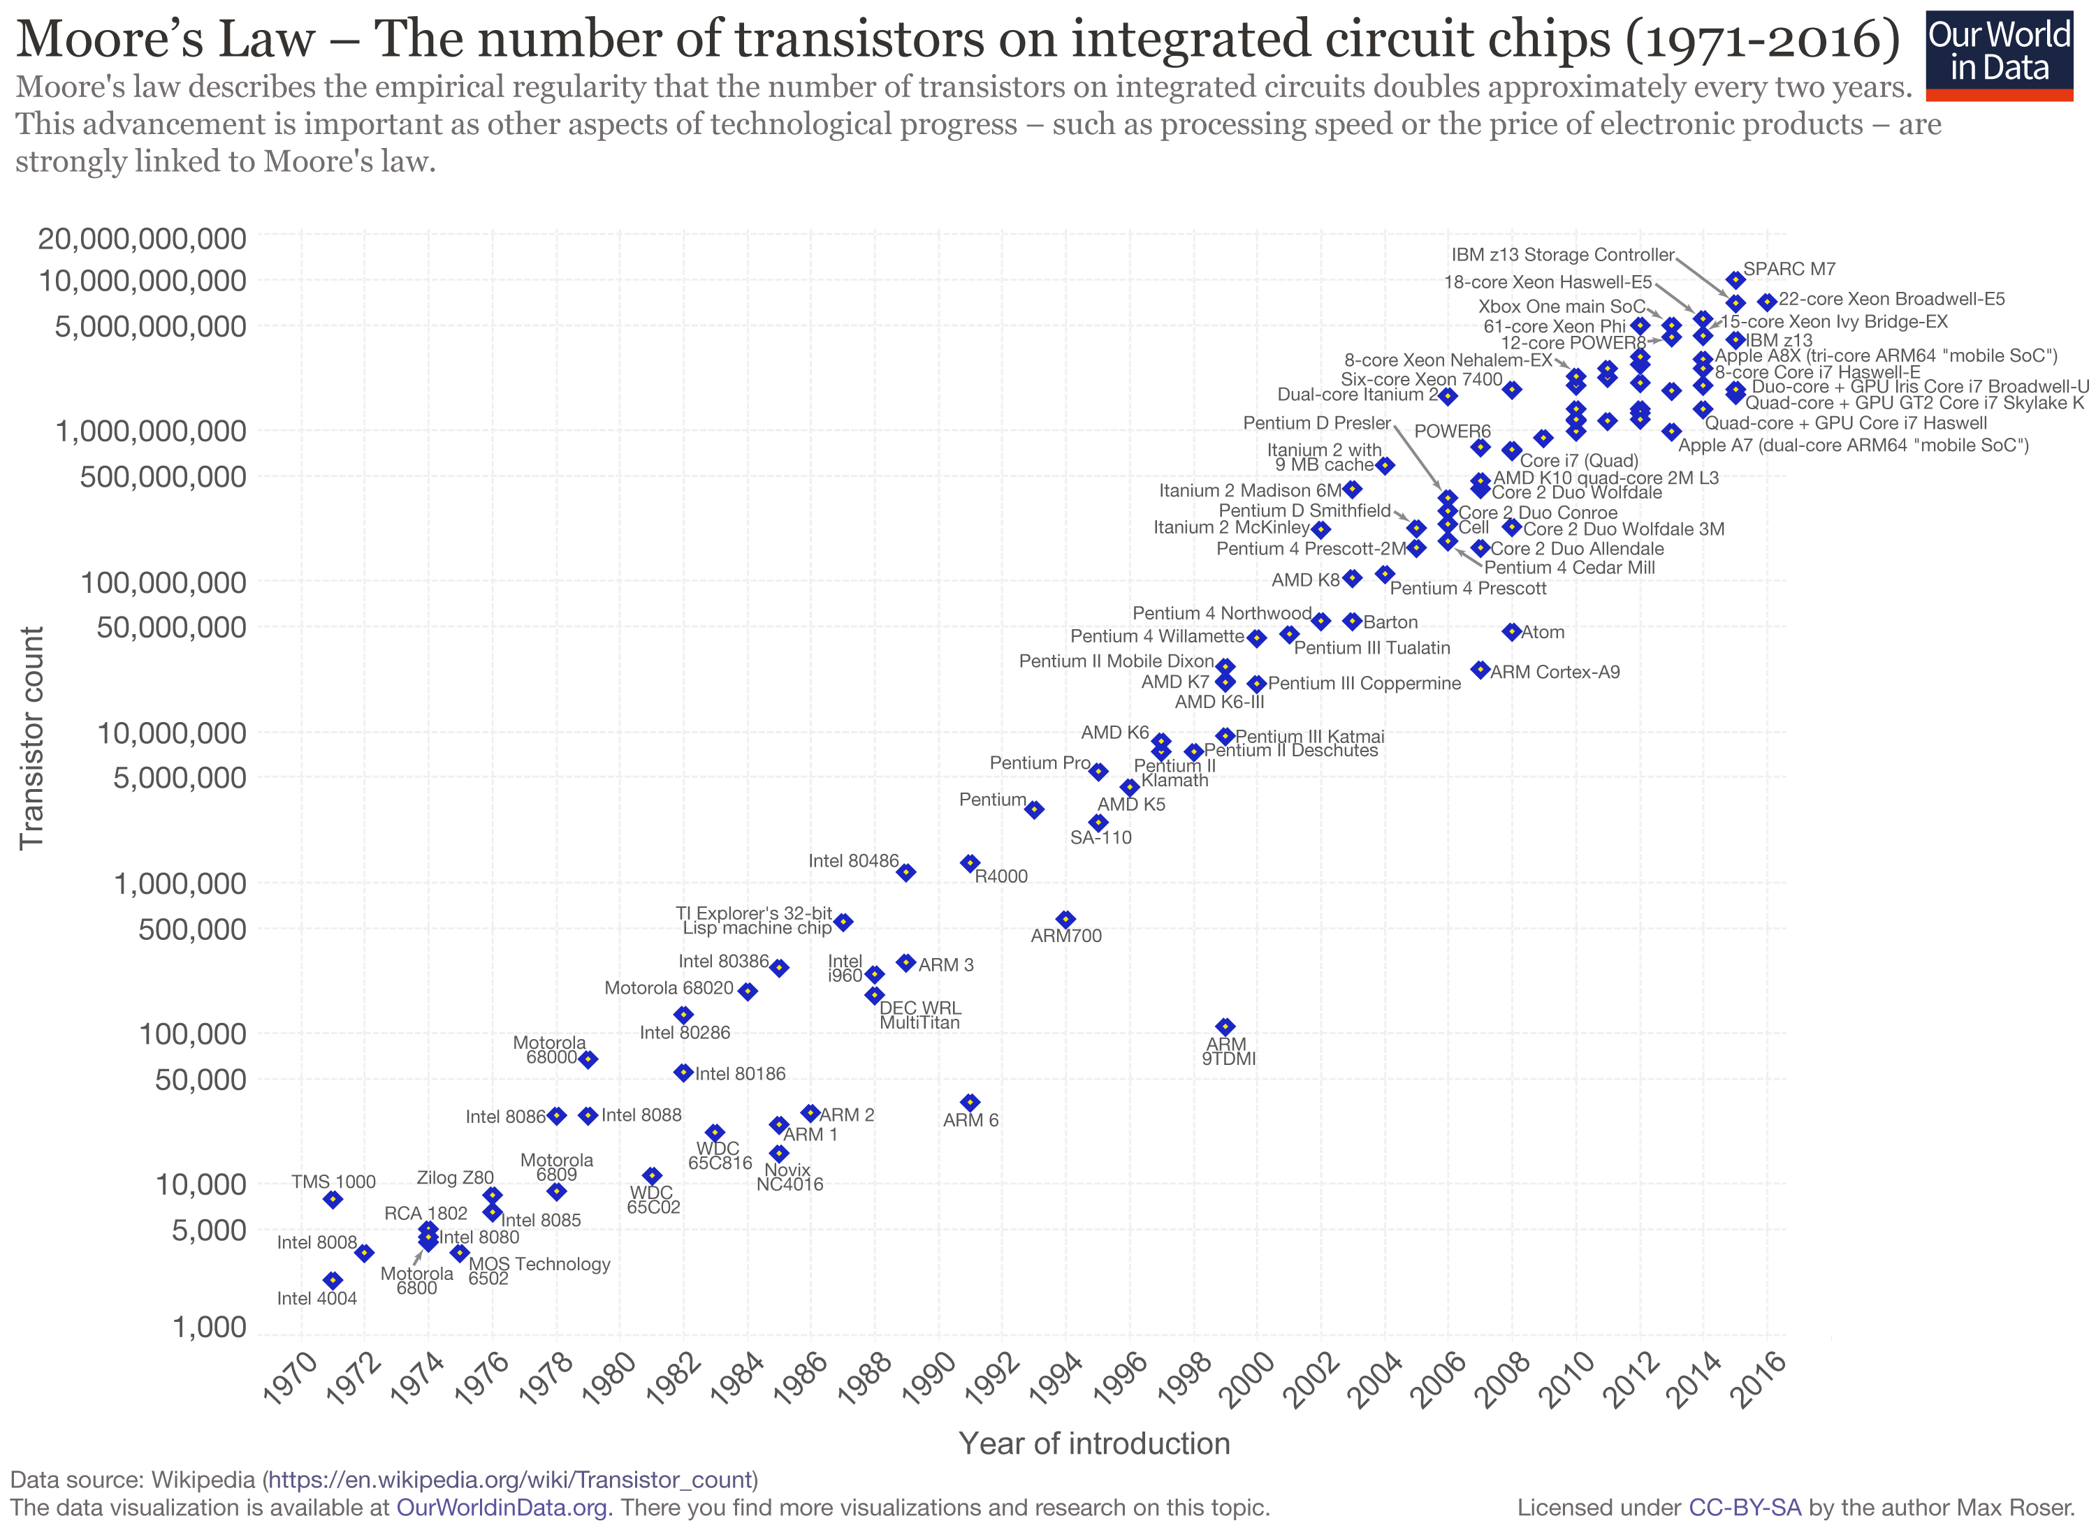
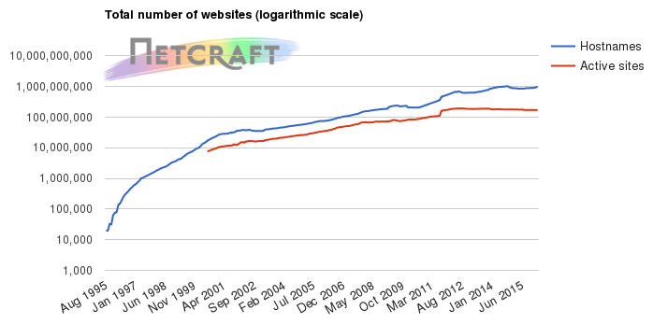
Scalability
Things (Problem sizes, processor speed, link speed, amount of data transferred on the Internet, number of hosts) in the field of computers grow exponentially.
Any solution, application, architecture should be scalable which means:
It should still be useful when the original problem size grows by a large factor

Slide 73
Scalability
Client server file distribution:
Single server will crash when number of clients grow exponentially
Centralized: Does not scale wit the number of clients
P2P:
There is no single server, a large number of clients participate in the file download
Tracker is a limit
P2P is a distributed application, it scales with the number of files and participants
DNS:
url to IP address mapping cannot be handled by a single server
DNS is a distributed database, it scales with number of hosts and IP mappings, clients that query

Slide 74
Application Layer

